Slide 1
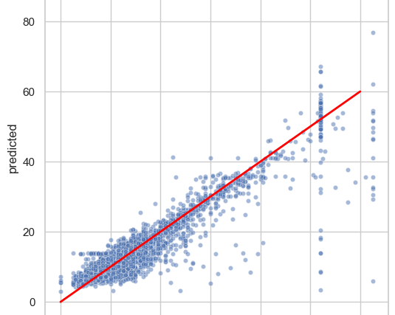
Regression Model For Predicting Taxi Fares
Executive summary report for the New York City Taxi and Limousine Commission
In order to showcase the efficacy of the linear regression model, the Automatidata data team included a scatter plot comparing the predicted and actual fare amount. This model can be used to predict the fare amount of taxi cab rides with reasonable confidence. The provided notebook exhibits further analysis on the model residuals.
New York City Taxi & Limousine Commission has contracted the Automatidata data team to predict taxi fares.The Automatidata team created a deliverable of regression model as per client request.
The Automatidata data team chose to build a multiple linear regression model based on the type of data and distribution of data provided.The MLR showed a successful model that estimates taxi cab fares prior to the ride. The model performance is high on both training and test sets.Suggesting model is not over-biased or over-fitting
Image : The scatter plot shows a linear regression model plot illustrating predicted and actual fare amount for taxi cab rides.
Model metrics:
Net model tuning resulted in:
R^2 0.87, meaning that 86.8% of the variance is described by the model.
MAE 2.1
MSE: 14.36
RMSE 3.8
Imputing outliers helps model performance, especially with regards to the fare amount and duration variables. The model is very good at predicting estimated fare amount of the taxi rides.
The feature with the greatest effect on fare amount was ride duration, which was not unexpected. The model revealed a mean increase of $7 for each additional minute, however, this is not a reliable benchmark due to high correlation between some features.
Request additional data from under-represented itineraries
The New York City Taxi and Limousine commission can use these findings to create an app that allows users (TLC riders) to see the estimated fare before their ride begins.
The model provides a generally strong and reliable fare prediction that can be used in downstream modeling efforts.

